Slide 1
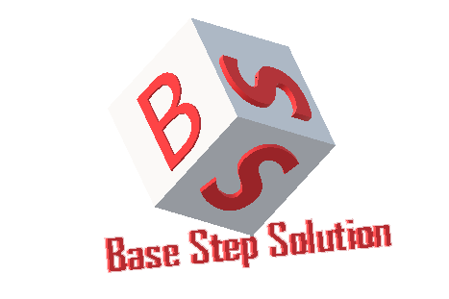
Capstone Project
Project: Van Lang Admission
Present: Base Step Solution

Slide 2
Agenda
Introduction
Planning phase
Development process
Requirement phase
Design phase
Implement phase
Testing phase
Monitoring and control
Reflection/ lesson learn
Demo

Slide 3

I. Introduction
I.1. Project stakeholder
Mentor
Nam Vu
BSS Team
Hien Nguyen
Tai Nguyen
Hai Tran
Khoi Nguyen
Minh Doan
Hien Thai Nguyen
Customer
Quang Nguyen

Slide 4
I. Introduction
I.2. Role
Role | Name
Project Manager | Tran Xuan Hai
Requirement Engineer | Doan Anh Minh Nguyen Anh Khoi
Architect Engineer | Tran Xuan Hai Nguyen Thai Hien Nguyen Hoang Anh Tai
Developer | Tran Xuan Hai Nguyen Thai Hien Nguyen Hoang Anh Tai
Tester | Doan Anh Minh Nguyen Anh Khoi

Slide 5
I. Introduction
I.3. About Van Lang Admission project
Nowadays apply technology into admission of university is very important
and necessary.
With transform of admission and require from Ministry of Education and
Training that information relate to admission must be publish on website of
university.

Slide 6
I. Introduction
I.3. About Van Lang Admission project
Technical:
Database: mongoDB, redit, elasticsearch
Language: javascript
Framework: angularjs, ionic
Platform: nodejs

Slide 7
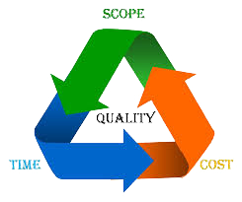
I. Introduction
I.4. Project scope
Time:
Stage 1: 6people * 4h *5days * 12weeks = 1440
Stage 2 : 5people * 8h *6days * 18weeks = 4320
Quality:
Provide website with main function as described in requirement document on time

Slide 8
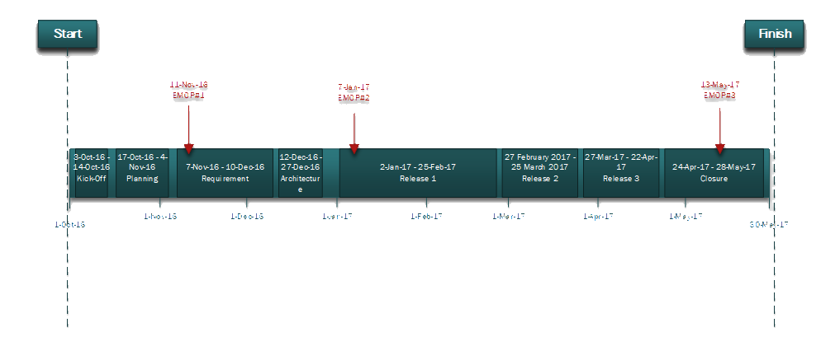
II. Planning phase
II.1. Milestone

Slide 9
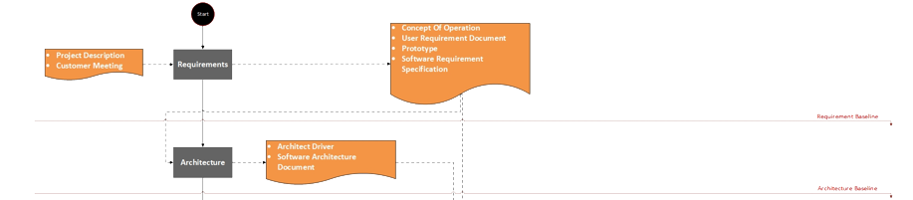
III. Development process
III.1. Process

Slide 10
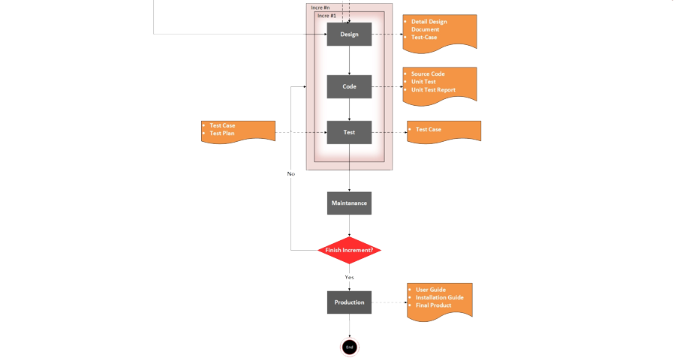
III. Development process
III.1. Process

Slide 11
III. Development process
S
Generates working software quickly and early
Customer can respond to each build
It is easier to test and debug
W
Need good planning and design
Need a clear and complete definition of whole system
O
Release the product to customer early
Help the team handle problems easier and mitigate risks
T
If architecture and requirement are not clear, team may have
rework a lot

Slide 12
IV. Requirement phase
IV.1. Duration

Slide 13
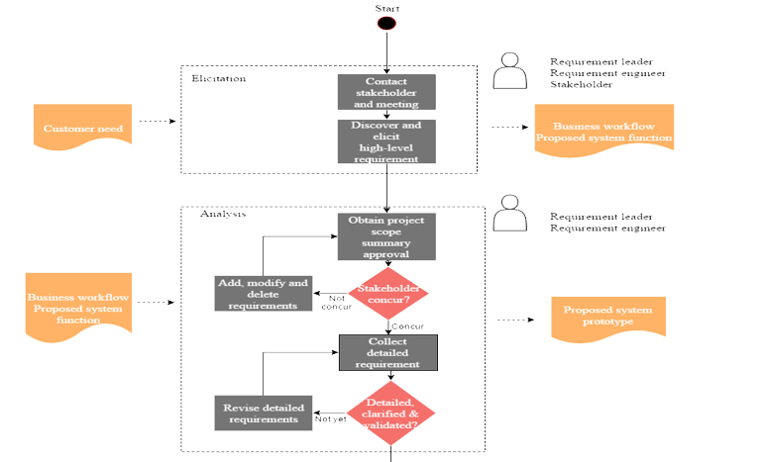
IV. Requirement phase
IV.2. Requirement development process

Slide 14
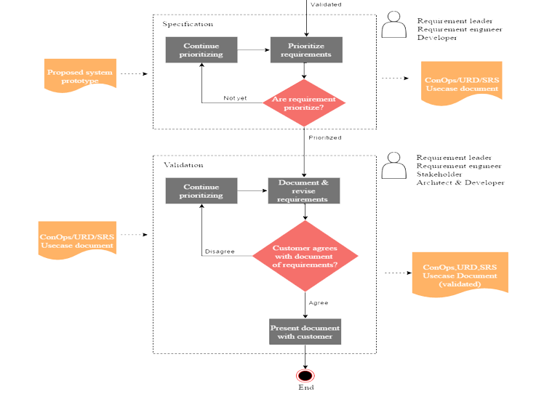
IV. Requirement phase

Slide 15
IV. Requirement phase
IV.3. Method-Functions
Requirement Technique: Prototyping
Brainstorming
Questionnaire
Interview
Requirement Tools: Draw.io
Prototyping

Slide 16
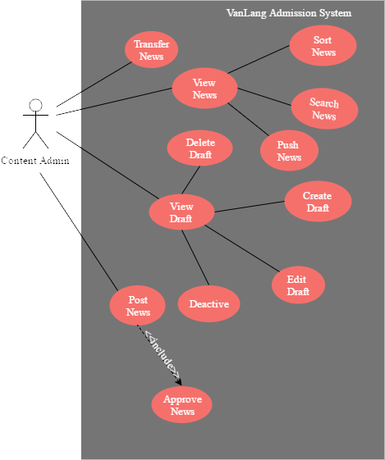
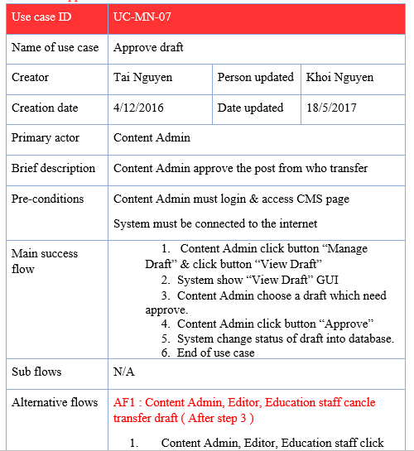
IV. Requirement phase
IV.4. Use case diagram

Slide 17
IV. Requirement phase
IV.5. Function prioritization

Slide 18
V. Design phase
V.1. Duration

Slide 19
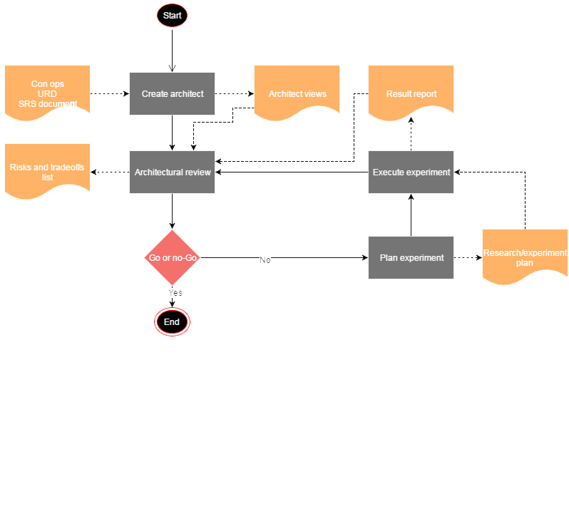
V. Design phase
V.2. Architecture and design process

Slide 20
V. Design phase
V.3. Physical view

Slide 21
V. Design phase
V.4. Static view

Slide 22
V. Design phase
V.5. Class diagram

Slide 23
V. Design phase
V.6. Dynamic view

Slide 24
V. Design phase
V.7. Sequence diagram

Slide 25
VI. Implement phase
VI.1. Duration

Slide 26
VI. Implement phase
VI.2. Incremental

Slide 27
VII. Testing phase
VII.1. Duration

Slide 28
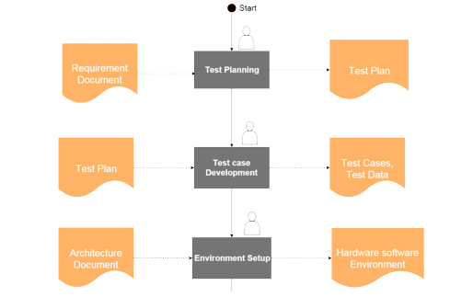
VII. Testing phase
VII.2. Testing process

Slide 29
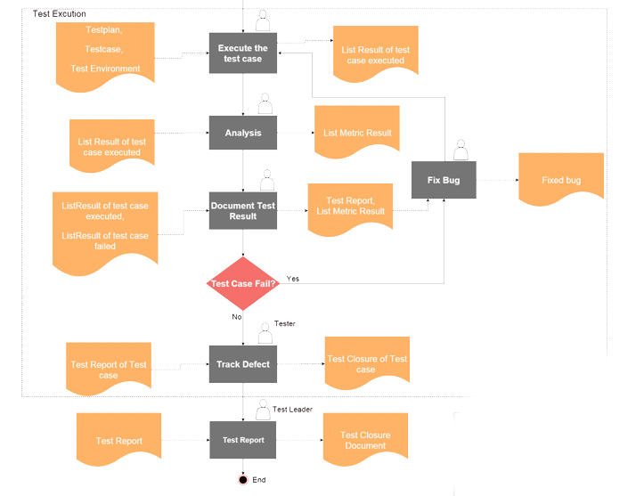
VII. Testing phase

Slide 30
VII. Testing phase
VII.3. Test report

Slide 31
VIII. Monitoring and Control
VIII.1. Measurement

Slide 32
VIII. Quality management
VIII.1.1. Measurement process

Slide 33
VIII. Quality management
VIII.1.2. Earned value chart

Slide 34
VIII. Quality management
VIII.1.3. Bull’s eye chart

Slide 35
VIII. Quality management
VIII.2. Change management

Slide 36
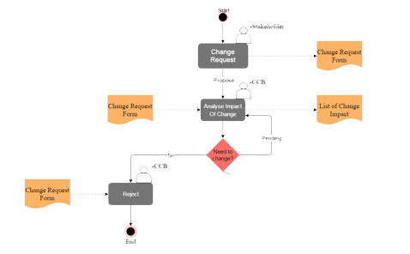
VIII. Quality management
VIII.2.1. Change management process

Slide 37
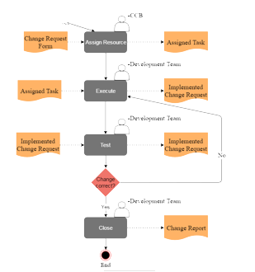
VIII. Quality management

Slide 38
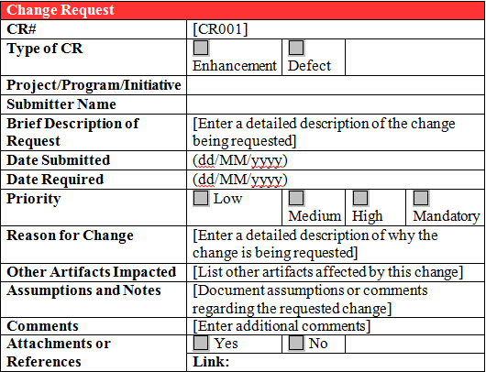
VIII. Quality management
VIII.2.2. Change request form

Slide 39
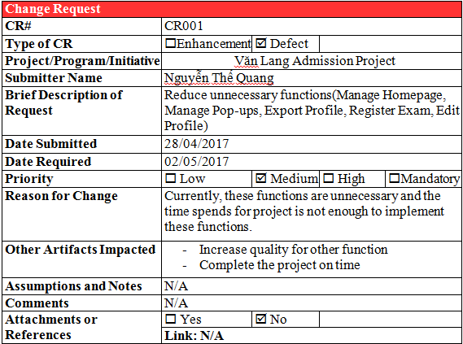
VIII. Quality management
VIII.2.2. Change request in the project

Slide 40
VIII. Quality management
VIII.3. Risk management

Slide 41
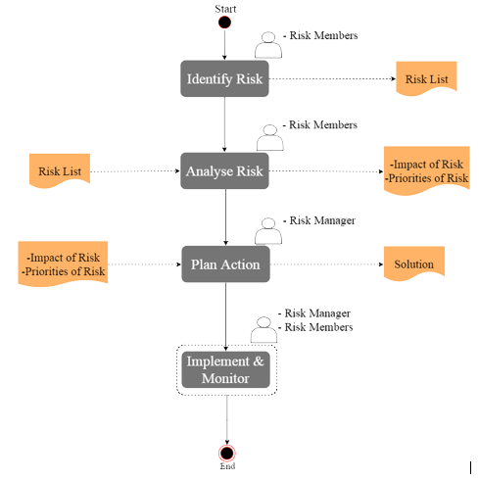
VIII. Quality management
VIII.3.1. Risk management process

Slide 42
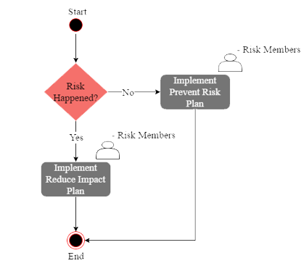
VIII. Quality management
VIII.3.2. Prevent and reduce risk process

Slide 43
IX. Reflection/ lesson learn

Slide 44
X. Demo

Slide 45
THANK YOU FOR YOUR ATTENTION

